Slide 1




Malignant Comment Classifier
Hinal Seth

Slide 2
Problem statement
Online hatred has been highlighted as a big problem on online social media platforms, and has been defined as abusive language, hostility, cyberbullying, hatefulness, and many other things. The most common venues for such toxic behaviour are social media platforms.
Our objective is to create a prototype of an online hate and abuse comment classifier that can be used to categorise and manage hate and offensive remarks in order to prevent the spread of hatred and cyberbullying.

Slide 3
Data pre-processing
As a first step I have imported required libraries and I have imported the dataset which was in csv format.
Cleaned the data from junk values. Replace multiple spaces with single space So that it will be easy to classify it.
I am creating a function for feature engineering and making three different columns using comment_text column Length: indicating the length of the text. Exclamation: indicates whether ‘!’ is present in the text or not. Question: indicates whether ‘?’ is present in the text or not.
By observing these comments we can say that we need to do lot of text processing as there are many words which are not important for prediction, as well as numbers and other stuff.

Slide 4
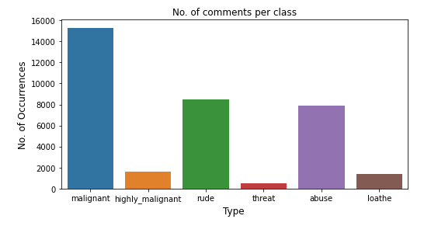
Visualization
The above figure represents count plot for all our labels. Looking at this plot we can conclude that more number of comments has been labelled as malignant compared to others. Very less number of comments has been labelled as threat.

Slide 5
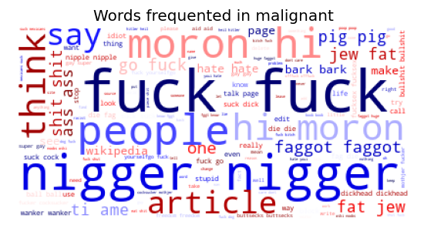
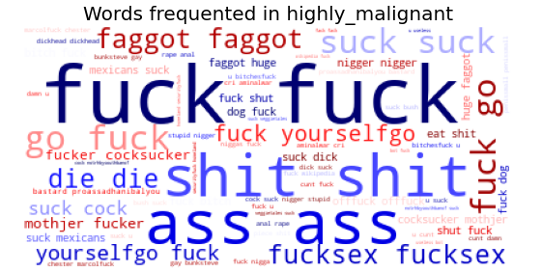
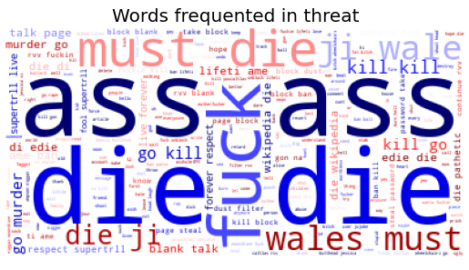
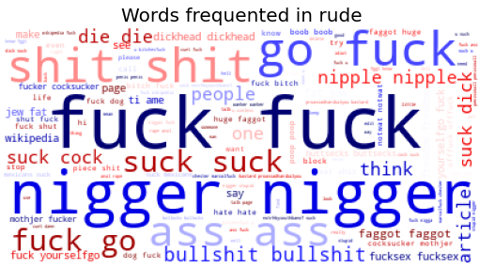

Slide 6
Evaluation Model
Among all the algorithms which I have used for this purpose I have chosen LinearSVC as best suitable algorithm for our final model as it is performing well compared to other algorithms while evaluating with different metrics I have used following algorithms and evaluated them:
Linear SVC
Logistic Regression
Multinomial Naïve Bayes
LGBM Classifier
SGD Classifier
Passive Aggressive Classifier
Decision Tree Classifier

Slide 7
Evaluation Metrics
F1 Score
Precision
Accuracy Score
Recall
Multilabel Confusion Matrics
Hamming loss
Jaccard Score

Slide 8
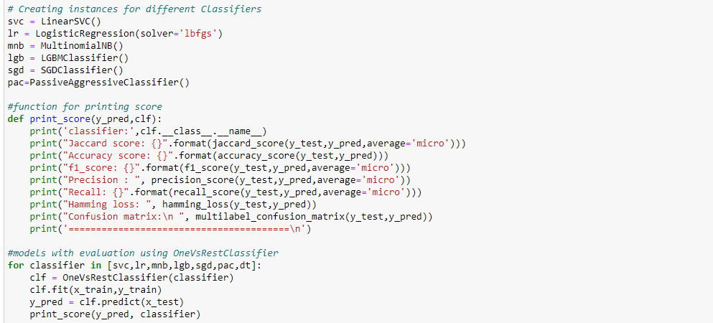
One v/s rest classifier

Slide 9
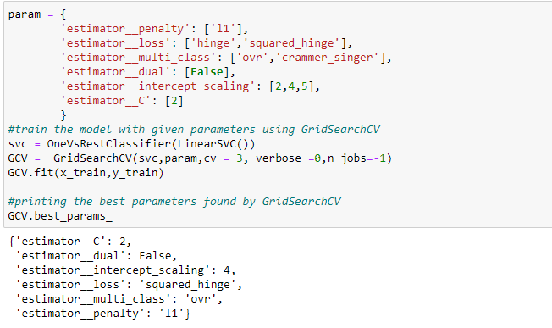
Hyper parameter tuning

Slide 10
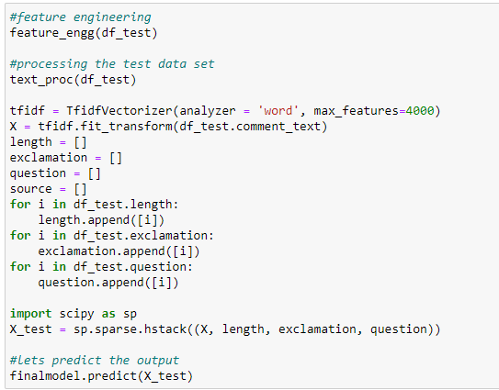
Final Model
The hyper parameter tuned SVC gives 91.9% accuracy.
The predicts are so accurate.

Slide 11
Conclusion
It is possible to classify comments content as malignant or not. Using this kind of project, we can create awareness about what’s good and what’s bad. Which can eventually lead to lessen the spread of Hatred among people.
To conclude, the application of machine learning in malignant classification is still at an early stage. We hope this study has moved a small step ahead in providing some methodological and empirical contributions to crediting institutes, and presenting an alternative approach to the valuation of malignance.
Thanks & Regards

